Slide 1

Overview of Equality, Diversity and Inclusion

Slide 2
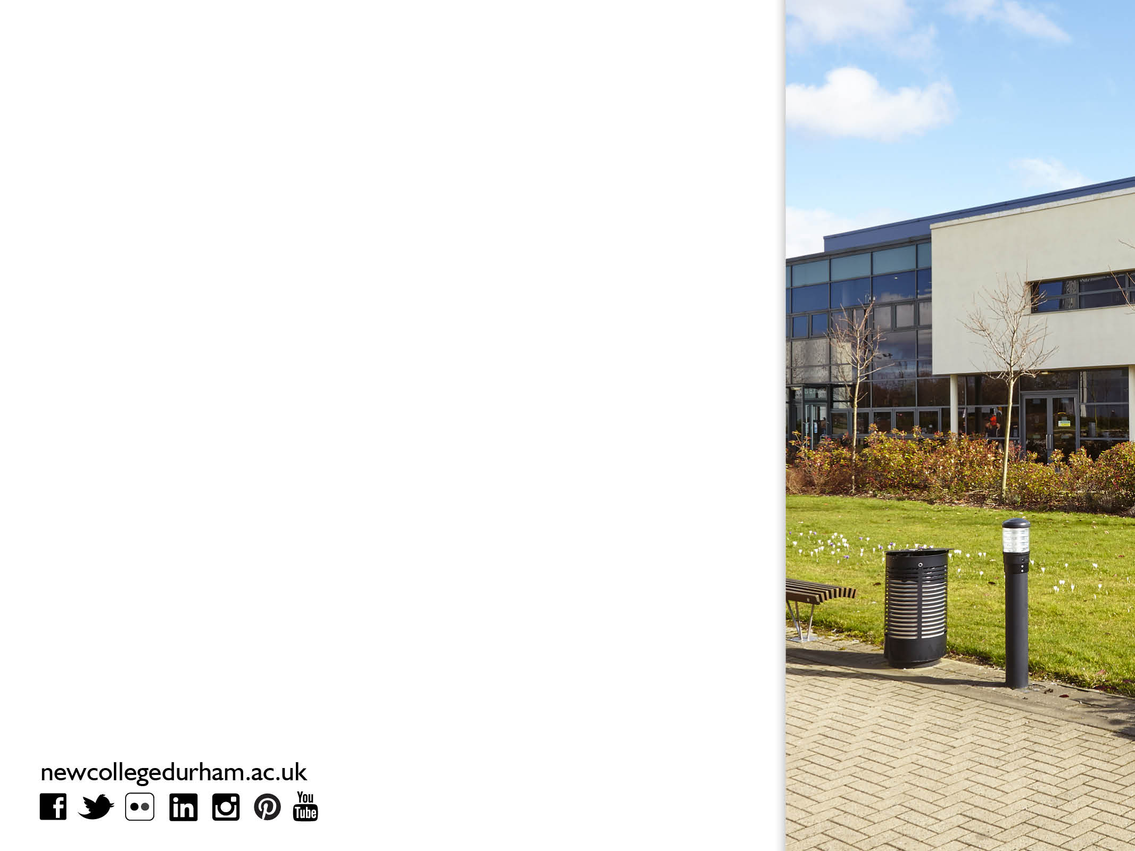
Key messages
Our commitment and approaches to Equality and Diversity.
Legislation requirements and their impact.
Governors - ‘Making a Difference’.
Leaders in Diversity.

Slide 3

Our commitment and approaches
We are committed to being a place where learning and working exists in an environment that :
Advancing equality and diversity and tackle all forms of discrimination.
Celebrating diversity and difference.
Seeking to educate students and the community to both foster good relations and recognise the benefits of a diverse community.
Staff and students play a vital role in helping the college to embed equality and diversity within all our practices.

Slide 4

Equality
Diversity
Inclusion
Recognising the skills, abilities and unique perspectives of our staff and students throughout the college.
Treating people fairly with dignity and respect.
Celebrating our differences and treating people in a way that they wish to be treated.

Slide 5

Key Facts
  Equality and Diversity is central to what we do and not an ‘add-on’;
  It is more than words it is actions!
  Our practices and services are legal, accessible and fair to all learners, service users and employees;
  Last Ofsted Inspection – July 2009 the College rated as overall ‘Outstanding’ - Equal Opportunities graded as ‘Good’;
  Held Leaders in Diversity since May 2016.

Slide 6

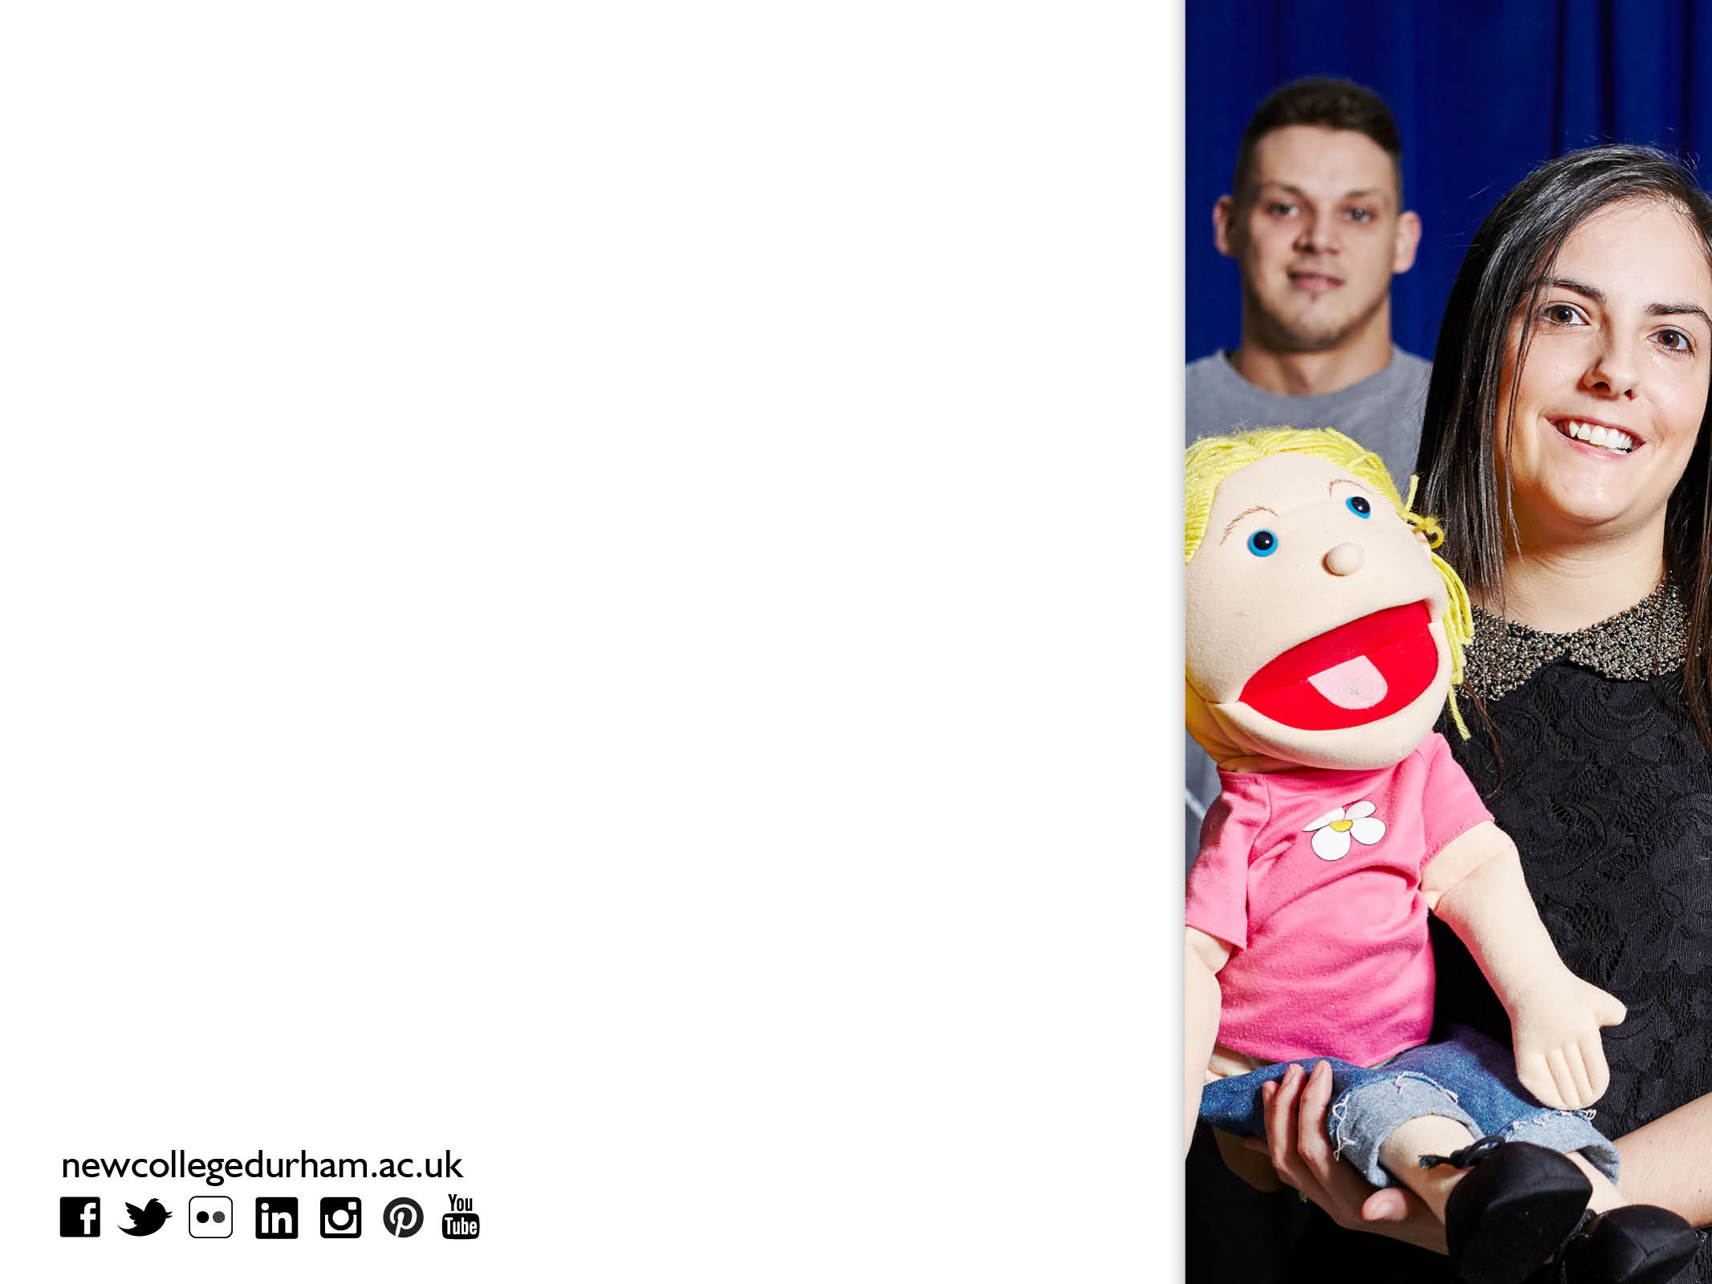
Equality Act 2010
Replaced previous legislation (such as the Race Relations Act 1976 and the Disability Discrimination Act 1995) and ensures consistency in what employers and employees need to do to make their workplaces a fair environment and comply with the law.
The Act applies to all organisations that offer a public service and to those that employ people including;
  FE Colleges;
Prospective students, enrolled students;
Governors and all Staff;
Anyone who sells goods or provides facilities;
It applies to all of our services, whether or not a charge is made for them.

Slide 7

Equality Act 2010
Defines definitions of discrimination;
Introduces a new Public Sector Equality Duty
Harmonise provisions allowing positive action;
Restricts circumstances employers can ask health/disability related questions in recruitment and selection;
Introduces and strengthens powers of Employment Tribunals to make recommendations to benefit wider workforce.

Slide 8

Why is Equality, Diversity and Inclusion important?
Under the Equality Act 2010, it is unlawful to discriminate against people at work because of nine areas termed in the legislation as protected characteristics.
These are;
Age
Disability
Gender reassignment
Marriage and civil partnership
Pregnancy and maternity
Race
Religion and belief
Sex
Sexual orientation

Slide 9

Equality Act 2010
The Act provides a consistent legal recognition of the following types of discrimination:
Direct discrimination including associative and perception;
Indirect discrimination;
Harassment;
Discrimination arising from a disability;
Failure to make reasonable adjustments;
Positive action verses positive discrimination.

Slide 10
Public Sector Equality Duty
The broad purpose of the duty is to integrate consideration of equality and good relations into the day-to-day business of public authorities.
In summary, those subject to the equality duty must, in the exercise of their functions, have due regard to the need to:
Eliminate unlawful discrimination, harassment and victimisation and other conduct prohibited by the Act.
Advance equality of opportunity between people who share a protected characteristic and those who do not.
Foster good relations between people who share a protected characteristic and those who do not.

Slide 11

Equality legislation
Despite 30 years of EQUALITY legislation the impact has been limited;
51% of the British population are women;
47% of the UK workforce are women;
Women are better educated than ever before, (girls outperform boys at both school and University);
Young, well qualified women enter the labour market in increasing numbers, as well as populating ranks of middle management.
These changes are not yet reflected in senior ranks of organisations.
Disabled people are more than twice as likely to be unemployed as non-disabled people;
In FE sector only 2% Principals & 6% managers are from
ethnic communities (10% in UK population);
6 out of 10 gay and lesbian school pupils experience homophobic bullying.
LEGISLATION IS NOT SUFFICIENT ON ITS OWN
03000 267979
03000 267979
03000 267979
03000 267979
03000 267979
Notes:
At the current rate of progress it will take another:
30 years to achieve an equal number of women senior police officers;
70 years to achieve an equal number of women Directors in the FTSE 100;
45 years to achieve an equal number of women in Senior Judiciary;
14 elections, or up to 70 years, to achieve an equal number of women MPs.

Slide 12

Single Equality Scheme
We will meet our legal duties under the Equality Act 2010 to promote equality by;
driving the agenda at the highest level
developing and raising awareness across the organisation
sharing good practice
working with learners, staff and external partners to address barriers faced by particular groups to allow full participation
monitoring, measuring and evaluating the impact of Equality and Diversity policies, and practice.

Slide 13

Embedding British Values and Prevent
Safeguarding and welfare at the heart of everything we do
Individual Liberty
Value choice, freedom and foster values in daily college life.
Democracy
Encourage and support staff/students to engage with democratic processes to inform decision making.
Mutual respect and tolerance
Work together to create a learning and working environment free from discrimination and harassment. Where inappropriate behaviour is challenged.
The rule of law
Governs the class, college and the wider community, staff and students understand that they are set for good reason and must be adhered to.

Slide 14
Ofsted
Inspectors will assess the extent to which;
we comply with legal duties as set out in the Equality Act 2010 and the Human Rights Act 1998;
we promote all forms of equality and foster greater understanding of protected characteristics of the Equality Act;
how well learners and staff are protected from harassment, bullying and discrimination, including those based with employers and at other sites external to the college;
we narrow any gaps in achievement between different groups of children and learners;
how well learners are prepared for successful life in modern Britain including promoting British Values.

Slide 15

Leaders in Diversity
Achieved in May 2016.
Constantly striving to move beyond legal compliance towards promoting and celebrating Equality, Diversity and Inclusion.
Given us a framework against we can analyse our performance and identify areas for further development and improvement.
Proud to have achieved Leaders in Diversity -demonstrates an all-encompassing methodology for improving Equality, Diversity and Inclusion practices and at the heart of everything we do.

Slide 16

Governors
Making a Difference
“It is the ‘responsible body’ who is liable for breaches of the Equality Act. Unless it can show that it took all reasonable steps to prevent the discrimination, harassment or victimisation from taking place”.
Monitor our Single Equality Scheme;
Set and publish our equality objectives together with evidence base;
Report and publish at least annually a range of information so others can judge how effective we are in meeting the general duty;

Slide 17

Reflection
We are all humans but we are not the same…
Every individual should have an equal chance to make the most of their talents, capabilities and endeavour; and no one should have poorer life chances because of where, what or to whom they were born.
We should all be treated with equal respect and have equal access to services, including education.
Equality is not about forcing equality upon people but giving people the chance to be equal and in some cases this means treating them differently.

